Slide 1
Knee, Leg, Ankle and Foot
Prof. Aranjan Karunanayake
MBBS, DM, DOH&S, Dip.Tox, Dipin. Coun, D.Sp.Med, FSS, MBASEM (UK), MSc.SEM (UK)

Slide 2
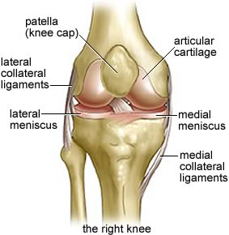
Knee joint
Synovial modified hinge joint.
Joint between femur, tibia and patella.
Muscles, ligaments, menisci and capsule support it.
Anterior cruciate - hyperextension injuries.
Menisci - twisting injuries while knee is flexed.
Medial meniscus gets injured more than lateral meniscus

Slide 3
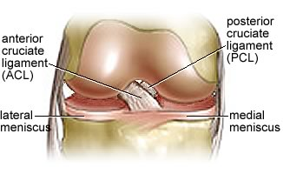
Injuries to Ligaments
Posterior cruciate - damaged in hyper flexion injuries,
Medial collateral – vulgus strain.
Lateral collateral – varus strain

Slide 4
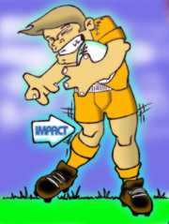
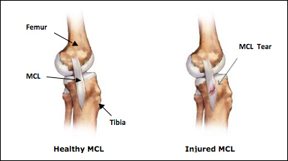
Vulgus strain on knee

Slide 5
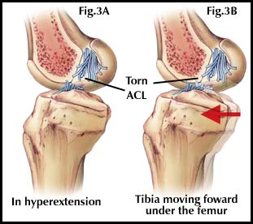
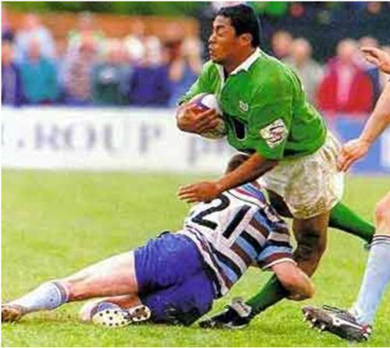
Hyper extension injury to knee

Slide 6
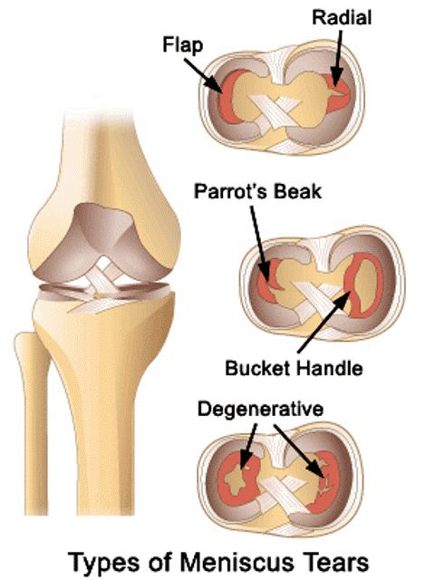
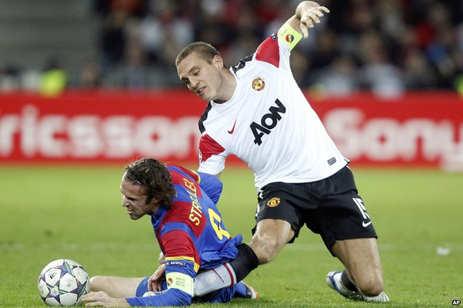
Meniscal injury

Slide 7
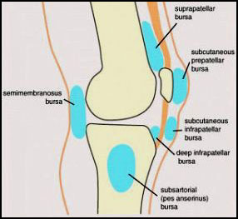
Bursa related to knee
Supra patella – largest. Communicates with knee
Infra patella – subcutaneous and deep.
Pre patella - subcutaneous
Semimembranosus bursa
Pes anserine bursa.
Can get inflamed during friction and cause pain

Slide 8
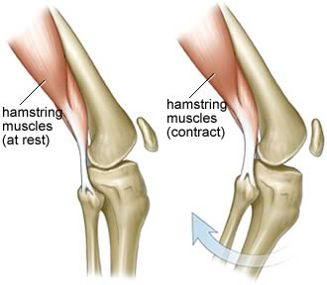
Movements of knee
Flexion – hamstring muscles mainly but gastrocnemius also helps.

Slide 9
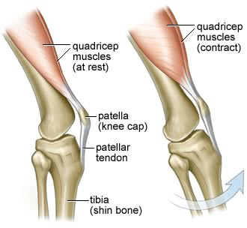
Movements of knee
Extension - Quadriceps femoris
Locking of the knee joint - The femur medial rotates on the tibia during last stages of extension. In locking knee is in full extension.
Action of quadriceps, size differences of femoral condyles and oblique pull of ligaments causes locking.
Popliteus helps in unlocking of the knee joint by lateral rotating the femur.

Slide 10
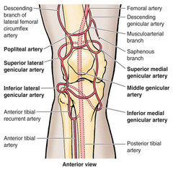
Arterial and Nerve supply
There is an anastomosis of branches of femoral, popliteal and tibial arteries.
These arteries gives several genicular arteries.
Nerve supply –
Femoral,
Obturator
Sciatic nerve branches

Slide 11
Objectives-
Describe the bones of the leg and foot
Describe the muscles of the leg and foot
Describe the compartments of the leg
Describe the ankle joint
Describe the compartments of the foot with arches.
Describe the muscles acting on the ankle and foot
Describe the vascular and nerve supply to the lower limb.
Describe the arches of the foot
Applied and clinical anatomy of lower limb.

Slide 12
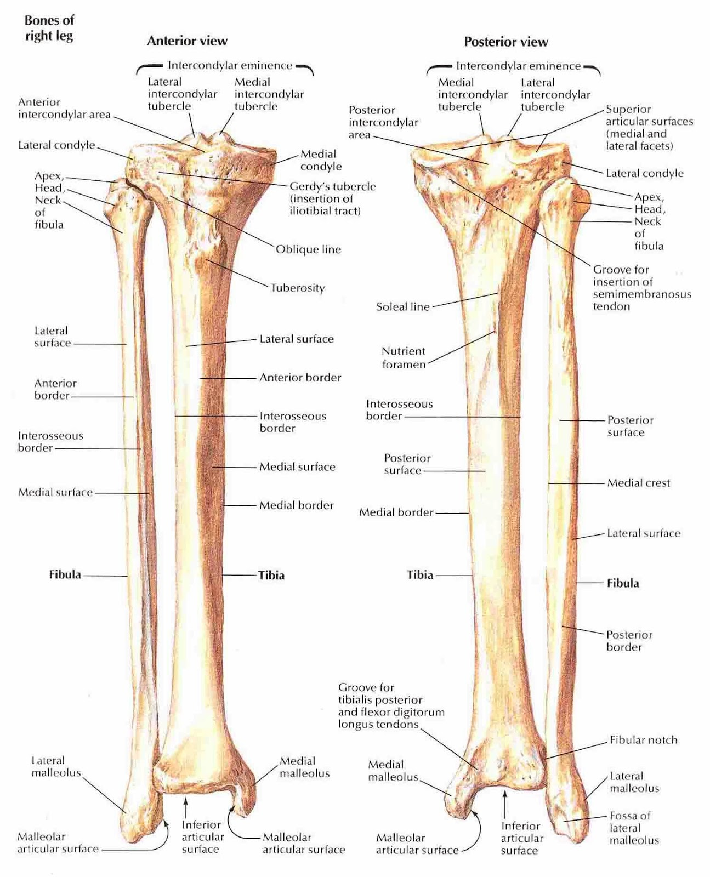
Bones of the leg

Slide 13
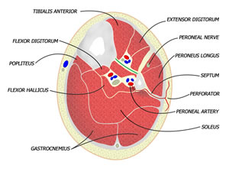
Compartments of the leg
Anterior, lateral, posterior. Medial compartment is subcutaneous
If there is bleeding pressure can rise and cause necrosis in these compartments.
4 compartments are present in posterior leg.
Tibialis posterior lies in deepest and gastrocnemius lies in the most superficial compartment

Slide 14
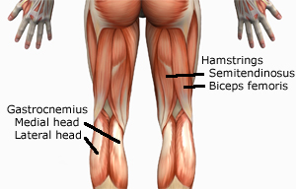
Superficial muscles of back of leg
Muscles-
Medial and lateral head of gastrocnemius.
Supplied by Tibial nerve.
Causes plantar flexion at ankle joint with soleus

Slide 15
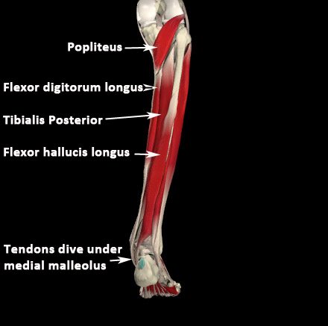
Deep muscles of the back of leg
Soleus
Flexor digitorum longus (FDL)
Flexor hallucis longus (FHL)
Popliteus – helps to unlock the knee joint
Tibialis posterior
Help in flexion of the ankle joint. FDL and FHL flexes the toes and hallux
Supplied by tibial nerve

Slide 16
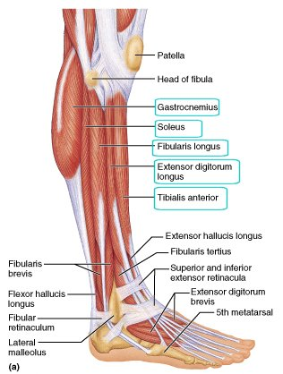
Muscles of anterior and lateral compartments
Anterior –
Tibialis anterior, extensor hallucis longus, extensor digitorum longus, peroneus tertius.
They are dorsiflexors of ankle joint. Supplied by deep peroneal nerve
Lateral –
Peroneus longus and Peroneus brevis
They are everters of ankle joint and supplied by superficial peroneal nerve

Slide 17
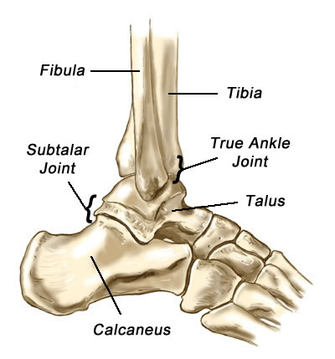
Ankle Joint
Joint between tibia, fibula and talus.
Joint between talus and calcaneous is called subtalar joint.
It is a synovial joint of hinge variety.
Bony socket, capsule, ligaments and muscles surrounding the joint provides stability.

Slide 18
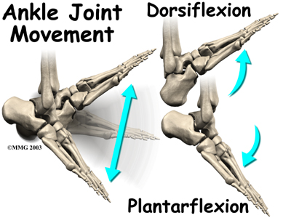
Movements
Plantar flexion
and
Dorsi flexion occurs in the tibio talo joints.
Inversion
and
Eversion occurs in the subtalar joints.

Slide 19
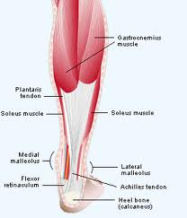
Muscles acting on the ankle joint
Posterior leg muscles causes plantar flexion. Especially by tendo Achilles. Plantar flexion is more than dorsi flexion because the talus is broader anteriorly.

Slide 20
Muscles acting on the ankle
Dorsi flexion is caused by Tibialis anterior, extensor hallucis longus, extensor digitorum longus and peroneus tertius.
These are supplied by deep peroneal nerve. If paralysed causes a foot drop.
Peroneus longus and brevis causes eversion of the foot.
Supplied by superficial peroneal nerve

Slide 21
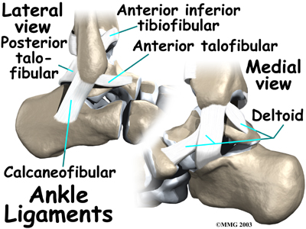
Ligaments of the ankle
Deltoid ligament-
Strong ligament on medial side of ankle. Slips extend from tibia to talus and calcaneal and navicular bones.
Talo fibular ligaments-
Anterior talo fibular, posterior talo fibular and calcaneo fibular ligaments are the parts. Anterior talo fibular is the commonly injured ligament and injuries occur usually during inversion type of injury.

Slide 22
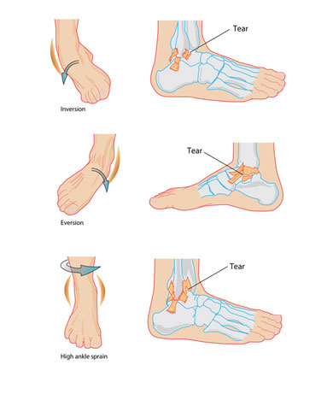
Movements and injuries
Eversion can cause medial ligament injuries.
Inversion can cause lateral ligament injuries.
Rotatory movements can cause high ankle injury.

Slide 23
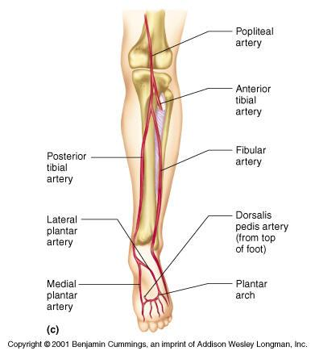
Arterial supply
Femoral artery and its branches to thigh.
Anterior tibial – anterior leg and dorsum of foot. Anterior tibial continues into the dorsum of the foot as dorsalis pedis artery.
Peroneal (fibular) – is a branch of posterior tibial artery. It supplies the lateral compartment.
Posterior tibial supplies the posterior compartment and the sole of the foot.

Slide 24
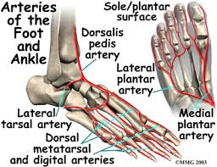
Arteries of foot
Anterior tibial becomes dorsalis pedis artery.
Posterior tibial gives rise to medial and lateral plantar arteries

Slide 25
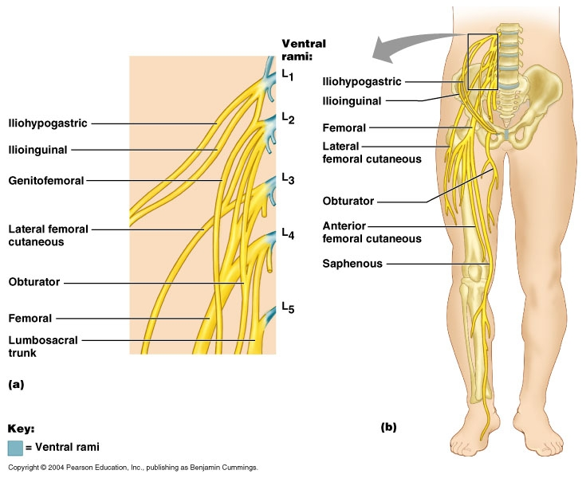
Nerves of lower limb
Femoral nerve and branches
Supply the anterior and lateral thigh
Sciatic nerve – posterior thigh muscles
Obturator – medial thigh
Tibial nerve – branch of sciatic nerve. Supply posterior leg muscles and muscles of sole of foot
Superficial peroneal – supplies muscles of lateral compartment of leg and sensory supply to leg and foot.
Deep peroneal – supplies dorsiflexors of foot and sensory to 1st cleft of foot

Slide 26
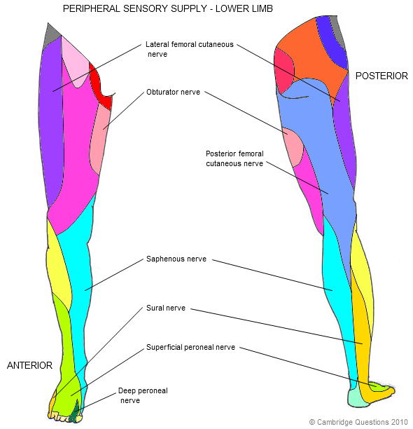
Sensory supply
Obturator
Femoral and its branches
Posterior cutaneous nerve of thigh
Saphenous nerve
Sural nerve
Superficial and deep peroneal nerve.

Slide 27
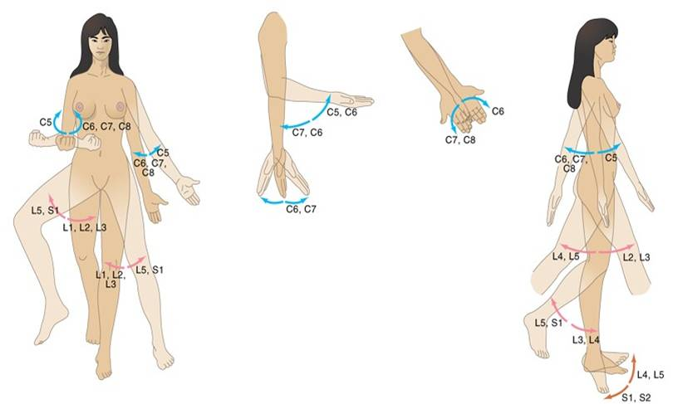
Myotomes of Upper and lower limbs

Slide 28
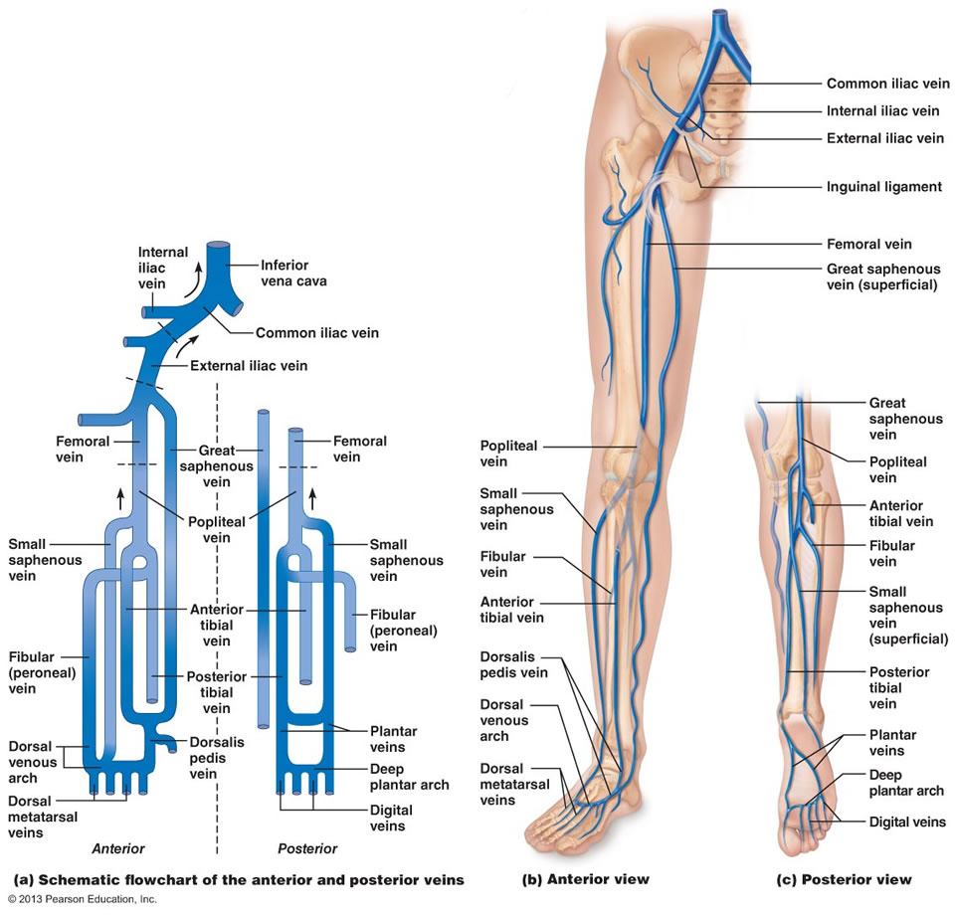
Venous system of lower limbs
The veins of the lower extremities can be divided into
Deep veins (surrounded by muscular tissue) The superficial veins include the greater and lesser saphenous veins, along with their major tributaries.
Perforator veins penetrate the fascia that surrounds the muscle bundles and divert blood from the superficial to the deep venous system
These veins are thin walled and low pressure vessels. Has valves.
Factors that facilitate flow towards the thorax
Low central pressures in the chest cavity. Active propulsion of blood by muscular contraction in the calves and thighs during ambulation.
Valves that prevent the backward flow of blood.

Slide 29
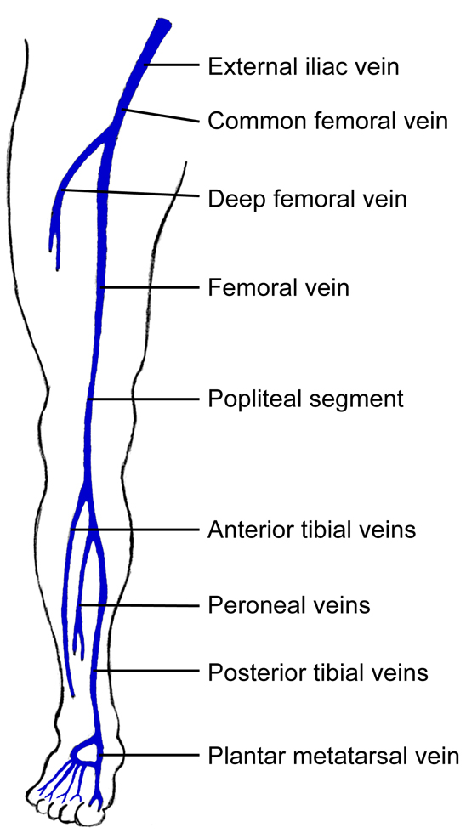
Deep venous system
The deep veins include the
Anterior tibial
Posterior tibial
Peroneal
Gastrocnemius
(veins in the calf)
Popliteal veins behind the knee, Femoral veins in the thigh.
Deep veins are ultimately responsible for most of the venous drainage from the lower extremities.

Slide 30
Superficial venous system
Two main veins.
Greater saphenous vein –
Starts from dorsal venous arch and ascends along the medial side of the calf and thigh and ultimately drains into the femoral vein at the groin, through the sapheno femoral junction.
Major tributaries (branches) include the dorsal venous arch in the foot, posterior arch vein in the leg, posteromedial vein and anterolateral vein in the thigh, inferior epigastric vein, external pudendal and circumflex iliac veins in the groin.
Useful for venous cut down.
Tourniquet might trap the saphenous nerve
Short (lesser) vein –
Starts from dorsal venous arch and ascends on the postero lateral aspect of the calf and drains into the popliteal venous system behind the knee, through the saphenopopliteal junction. Sometimes the lesser saphenous vein drains into other venous channels.

Slide 31
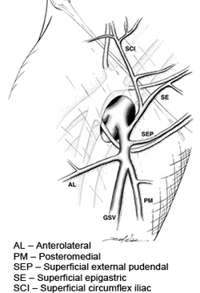
Tributaries at sapheno femoral opening
Superficial external pudendal
Superficial epigastric
Superficial circumflex iliac
Antero lateral
Postero medial
These may need to be ligated during surgery for varicose veins.

Slide 32
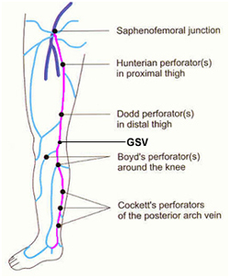
Perforating venous system
There are a number of perforating veins that communicate between the superficial and deep venous systems.
These perforating veins are quite variable in their location and prevalence.
The function of perforating veins is to direct blood flow from the superficial venous system to the deep venous system. When incompetent can give rise to the development of varicose veins.
Classically defined perforating veins include the Hunterian and Dodd perforators in the thigh, the Boyd and Cockett perforators in the calf, and a number of perforators in the foot.

Slide 33
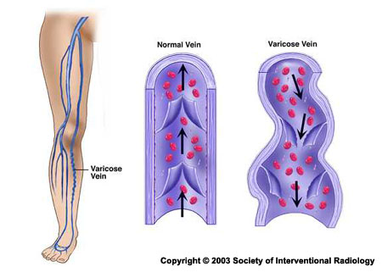
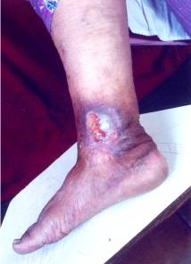
Varicose veins and ulcers

Slide 34
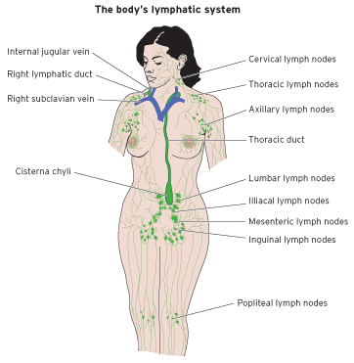
Lymphatic drainage
Lymphatics of lower limb drain into
Popliteal and inguinal lymph nodes.
Inguinal lymph nodes are arranged into superficial and deep lymph nodes. These lymph nodes are arranged into vertical and horizontal groups.

Slide 35
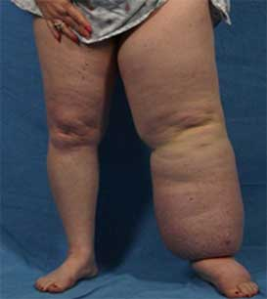
Lymph Oedema
Filarial infections
Malignancy
Treatment for malignancy

Slide 36
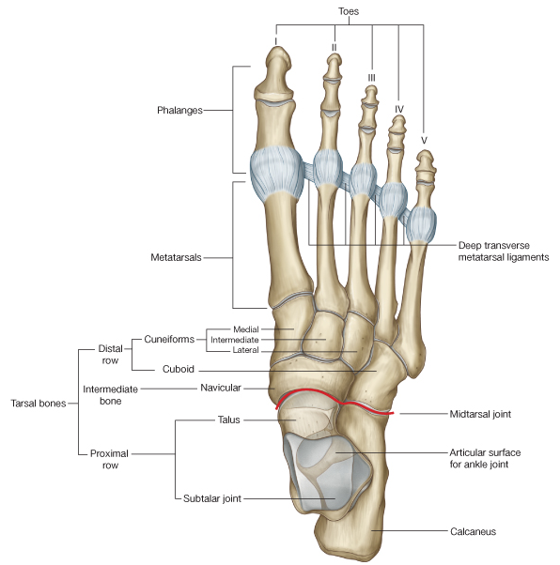
Bones of ankle and foot-
Talus
Calcaneus
Naviculum
Cuboid
Medial, intermediate and lateral cuneiforms
5 metatarsals
Phalanges – 2 for 1st Toe and other 4 toes have 3 phalanges each.

Slide 37
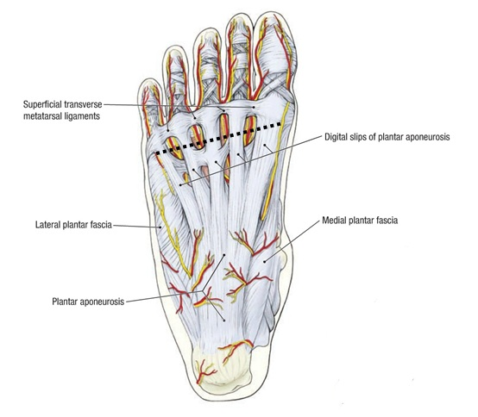
Plantar aponeurosis
Formed by deep fascia.
Apex lies proximally and base lies distally. Base divides into five slips.
Its connected with the skin and flexor sheaths of toes
Supports the arches (like a tie beam), protects soft tissues.
Sends medial and lateral vertical intermuscular septa.
Thin transverse septa arises from vertical septa to divide foot into compartments.

Slide 38
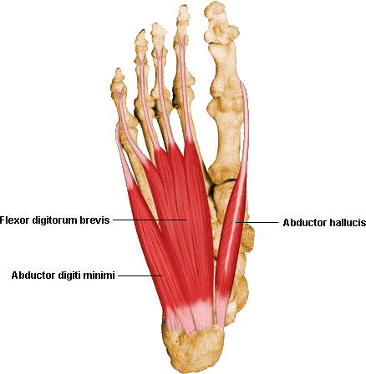
Muscles of 1st layer
1.Abductor hallucis
2.Flexor digitorum brevis
(supplied by medial plantar)
3.Abductor digiti minimi is supplied by lateral plantar nerve

Slide 39
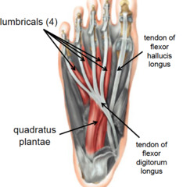
Muscles of 2nd layer
1.Flexor digitorum longus
2.Flexor hallucis longus
Intrinsic muscles
3. lumbricals
4. Quadratus plantae
1st lumbrical by medial plantar nerve and other 3 lumbricals and quadratus plantae by lateral plantar nerve
Lumbrical causes flexion at metacarpo phalangeal joints and extension at interphalangeal joints.
Quadratus plantae straightens the pull of long flexor tendons

Slide 40
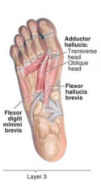
Muscles of 3rd layer
1.Adductor hallucis
2.Flexor digiti minimi brevis
(supplied by lateral plantar nerve)
3.Flexor hallucis brevis
Supplied by medial plantar nerve

Slide 41
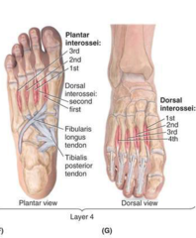
Muscles of 4th layer
3 plantar interossei
4 dorsal interossei
Tendons of tibialis posterior
Tendon of peroneus longus
(Interossei are supplied by lateral plantar nerve)
Palmar causes adduction and dorsal causes abduction
In addition causes flexion at metacarpo phalangeal joints and extension at the inter phalangeal joints.

Slide 42
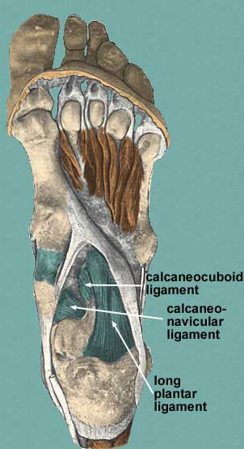
Ligaments of the foot-
Supports arches like tie beams.
1.Long plantar
2.Short plantar
3.Calcaneo navicular ligament
4.Calcaneo cuboid ligament

Slide 43
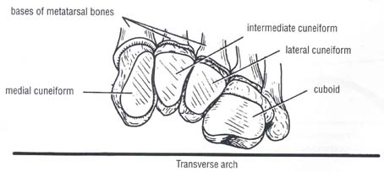
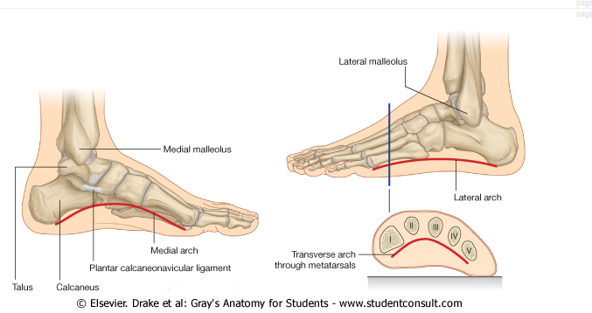
Two transverse and longitudinal arches

Slide 44
Functions of the arches-
Protects soft tissues in the sole
Helps to walk on uneven surfaces
Increases the efficacy of actions of tendons of foot during walking and running

Slide 45
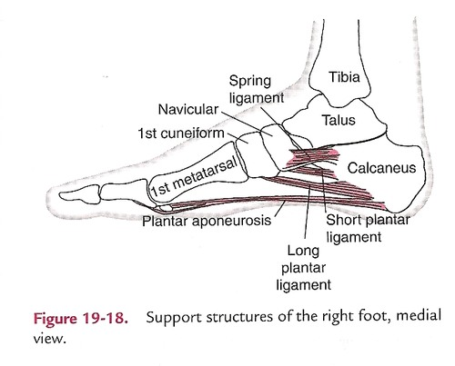
Supports of the arches of the foot
1.Tie beam like supports
a)Plantar aponeurosis
b).Ligaments
c).Short muscles of the foot
2.Tie rods like support
Muscles of the leg that reaches the foot such as tibialis posterior, flexor digitorum longus, peroneus longus.
3. Shape of the bones

Slide 46
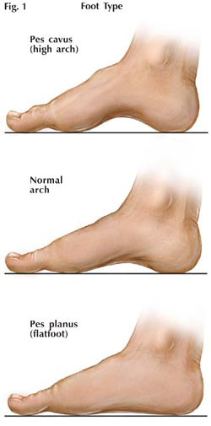
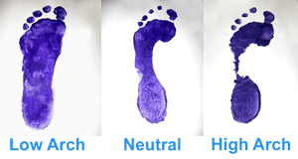
Arch abnormalities

Slide 47
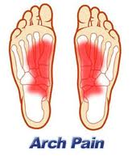
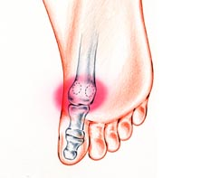
Clinical problems due to arches
Arch pain
Sesamoiditis

Slide 48
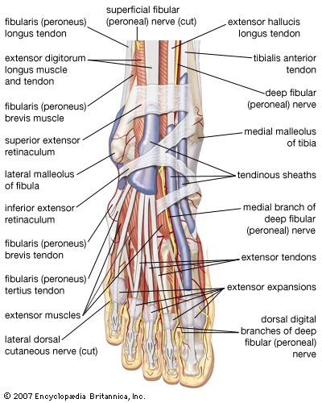
Tendons of the dorsum of the foot
Tibialis anterior
Extensor hallucis longus
Extensor digitorum
Peroneus tertius

Slide 49

Nerves of the leg and dorsum of the foot
1.Superficial peroneal nerve
2.Deep peroneal nerve
3.Sural nerve
4.Saphenous nerve

Slide 50

Arterial supply to the foot
Anterior tibial artery becomes the dorsalis pedis artery.
Dorsalis pedis artery gives the arcuate artery and 1st dorsal metatarsal artery. They give rise to metatarsal, digital and perforating arteries.

Slide 51
Arterial
Sole of the foot is supplied by posterior tibial artery.
It divides into medial and lateral plantar arteries.
They give rise to metatarsal and digital arteries.

Slide 52

Nerves of the sole of the foot
Tibial nerve divides into medial and lateral plantar nerves.
Medial plantar is the larger branch.
However lateral plantar supplies more intrinsic muscles of the foot.
Both supplies the skin of the sole.

Slide 53


Types of Tibial fractures

Slide 54


Fractures of malleoli (medial and lateral) and Talus

Slide 55


Lower limb stress fractures

Slide 56


Metatarsal and Phalangeal fractures

Slide 57

Gait cycle

Slide 58

Lower limb length measurements
True length –
It is measured from anterior superior iliac spine to the medial malleolus.
Apparent length –
It is measured from umbilicus to the medial malleolus

